Slide 1
Gopalakrishnan Employee_id :- 4361 Excel Assessment

Slide 2
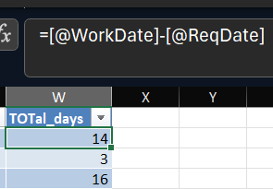
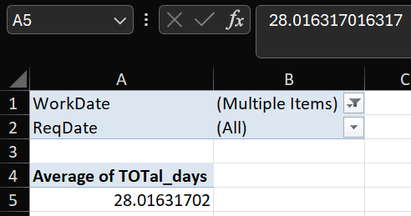
Q1.) - The average lead time between the requested date (ReqDate) and completion date (WorkDate) is ~28.02 days - Calculated the difference between WorkDate and ReqDate and verified it with thedifference between ReqDay and WorkDay - Filtered out the blanks from WorkDate - Summarized using Average

Slide 3
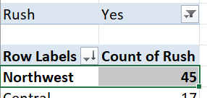
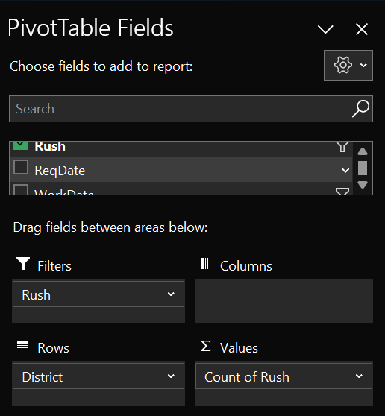
Q2.) - The district which has the highest number of rush jobs is Northwest with 45 rush jobs - Using pivot table, filtered out the Rush where it is “Yes” and sort the count of Rush per district in Largest to smallest

Slide 4
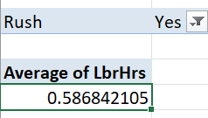
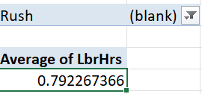
Q3.) - The average labour hours for non-rush days is more than rush days by ~0.2054 hours. - The average labour hours for rush days is ~0.586 hours - The average labour hours for non-rush days is ~0.792 hours

Slide 5
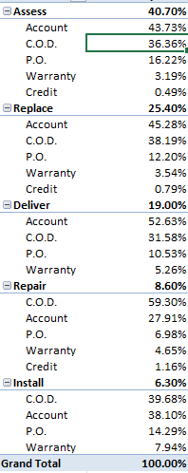
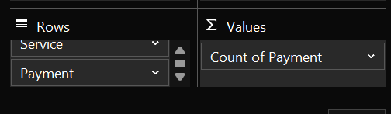
Q4.) - This is the distribution of payment types across different services - Used the Service and payment in rows and count of payment in values then summarized by % of parent total

Slide 6
Q5.) - There is an upward trend in the Account and C.O.D and P.O. and Warranty payment type from the beginning and downward trend in last few days - There is an upward trend in the credit payment type

Slide 7
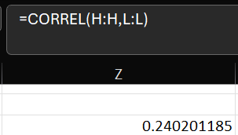
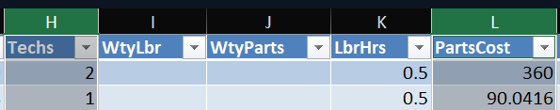
Q6.) - There is a positive correlation of 24% between the “number of techs” and “Parts cost” - Hence, there is little to No relationship between the “number of techs” and “Parts cost”

Slide 8
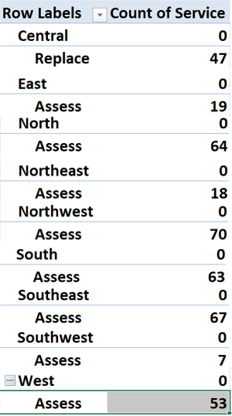
Q7.) - Central region has Replace as the most common type of service - East, North, Northeast, Northwest, South, Southeast, Southwest, West have Assess as the most common type of service

Slide 9
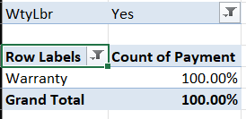
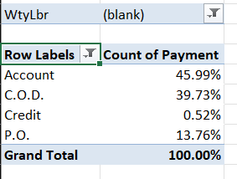
Q8.) - Everyone with warranty labour as “Yes” has paid through the payment method “Warranty” - The ones without warranty labour have used Account, C.O.D., Credit and P.O. with ~46%, ~39.7%, ~0.52% and ~13.8% respectively. - Hence, yes there is a difference between the payment methods

Slide 10
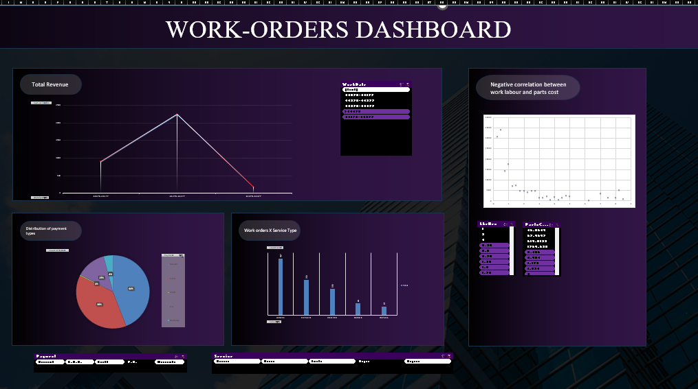
Q9.)

Slide 11
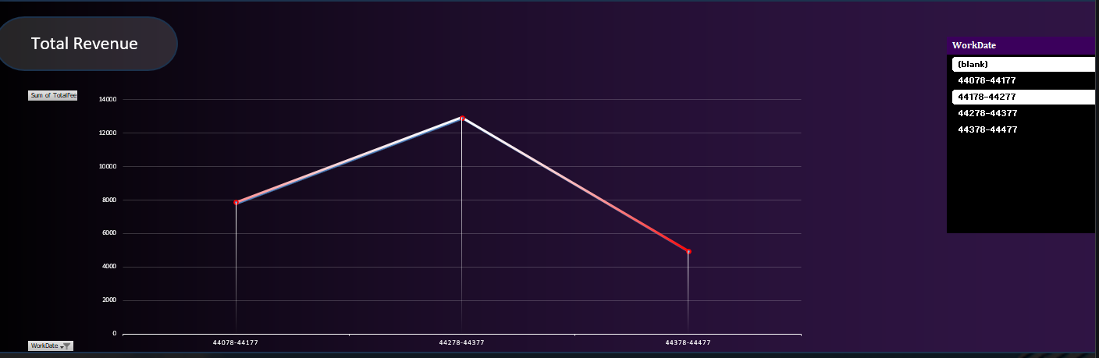
Q9.)

Slide 12
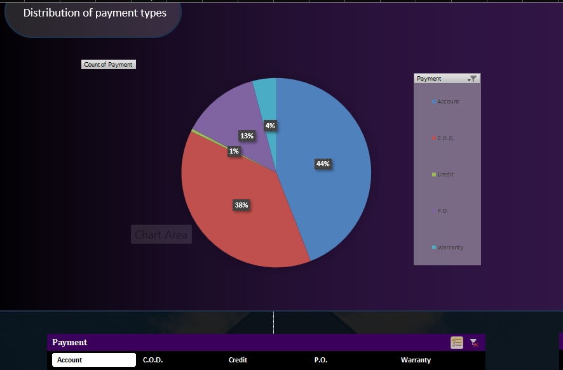
Q9.)

Slide 13
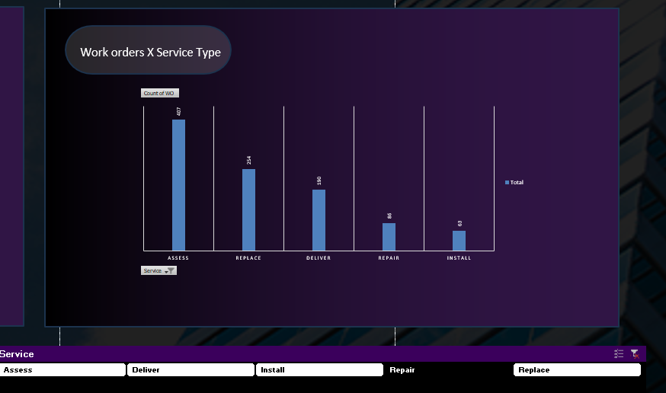
Q9.)

Slide 14
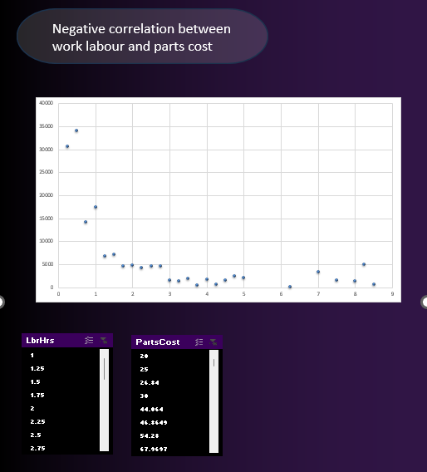
Q9.)

